Slide 1
Cultivating Creativity as A Project/Program Manager
Our Profession: More Creative, Less Boring Than Advertised!

Slide 2
What’s This About?
At it’s heart, Creativity is a core Project and Program Manager ability.
This ability makes a serious difference in how we function as professionals.
We can understand this ability, cultivate it, and improve it.
Yes, I’m really, really serious, that’s why I built an extensive Powerpoint on this.
(Note: I like making presentations, so that’s not exactly a testimony.)

Slide 3
Who Am I?
Steve Savage, Project Manager, Program Manager, Speaker, Writer, and Elder Geek.
I write and speak on “Geeky” jobs, careers, creativity, and culture.
I also write and speak on creativity and code creativity tools
I can be reached at www.StevenSavage.com and my press site www.InformoTron.com

Slide 4
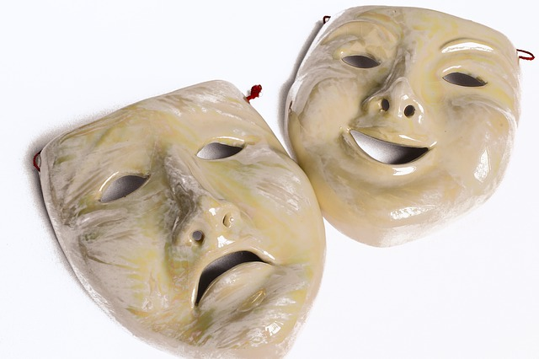
Project And Program Management: Actually Creative
Creativity: More Than Explaining Those Budget Numbers

Slide 5
We Don’t Think of PMing As Creative
It is about organization – which doesn’t seem creative
It is about tried and true techniques we use and apply – which doesn’t seem innovative.
It is about rational, clear communication – which seems to leave little room to get imaginative.
However this is all seems.

Slide 6
PMing Involves Constant Creativity
We must respond rapidly to the unexpected, the unexplained and the occasionally stupid – that needs creativity.
We must find ways to use and reuse tools and techniques – that requires creativity.
We must find solutions when no one else can – that requires creativity.
We must explain irrational things in rational ways – that requires creativity.

Slide 7
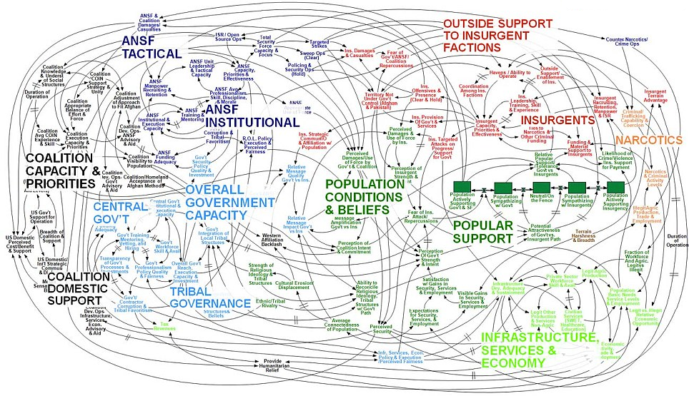
Going From Point A To B Is Hard
The typical project is more this:
(US Military diagram of Afghanistan political situation)

Slide 8
Our Profession Is Founded On It
Our careers rest on the seemingly crazy assumption that we can get people to organize and accomplish work when most people can’t remember when do to their laundry.
Yet, we do this all the time. Regularly. Spectacularly.
Our creative ability is one of the things that can make sure things get done.

Slide 9
So What’s Next?
Discuss the specifics of why creativity matters to the PM.
Recognize your creative style and that of others so you can develop your abilities – and overcome your weaknesses.
Learn how to cultivate your creativity
To use occasionally amusing graphics to entertain you.

Slide 10
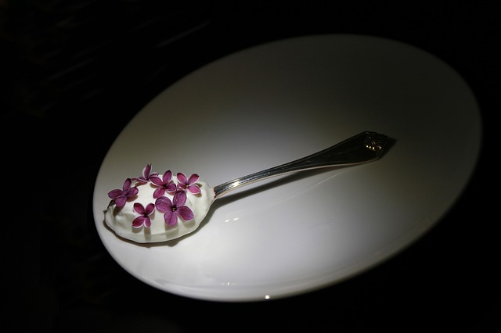
Creativity: The Secret Ingredient To Project Management
Apply Two Scoops of Imagination Right To Gantt Chart

Slide 11
Let’s Talk Why Creativity Matters
Some of us do not grasp the value of creativity in our field.
Those of us who recognize the creative element of our profession may not see all of it.
Even when we grasp it, we may not be able to communicate the value of creativity.
So it’s time for a quick tour!

Slide 12
Navigation
Few projects are a straight line between point A and point B.
Project Managers have to navigate a constant series of changes, challenges, functions, and dysfunctions. To get a project to completion.
We must make the non-linear and irrational linear and rational. Or at least tolerable.
Creativity helps us see navigation paths and opportunities.

Slide 13
Use Of Tools And Techniques
Tools and techniques are a core part of PMing.
We need to find the best way to use existing tools and techniques
We need to find ways to reuse existing tools and techniques.
We have to repurpose tools and techniques (I’m looking at you, Excel).
Creativity lets us use, reuse, and repurpose tools and techniques.

Slide 14
Development Of Tools And Techniques
We often have to develop new tools, techniques, forms, documents, processes, explanations, or excuses.
This can require leaps of logic, intuition, imagination, and outright chance-taking to make things work.
Creativity is core to us being able to develop tools and techniques.

Slide 15
Reporting And Communication
We have to develop reports and documents and communications.
There are many options, and we have to find the right way to do things.
This involves many fundamentally creative decisions.
We can also pleasantly surprise people with our innovative ideas – and help them understand.
Showing data and communicating is a creative act we all do.

Slide 16
Memorable
Being creative is how we’re remembered.
A good idea, a good explanation, a good document makes people remember us and what we do.
When they remember they (hopefully) keep doing the right things and recall important data.
Creativity means we’re remembered.

Slide 17
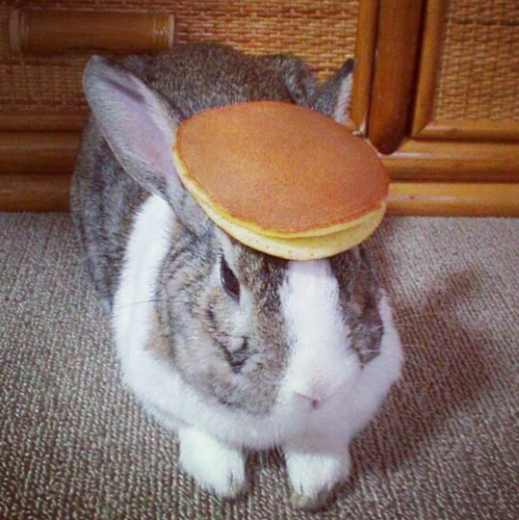
You Will Remember This
PMP:
Pet
Modeling
Pancake

Slide 18
Summary:
Creativity is a core part of our profession.
It is important to some of our most vital functions as PMs and PgMs.
If we cultivate it, we can become better at what we do.
It gives us an excuse to show pictures of rabbits wearing breakfast foods at professional symposiums.

Slide 19
Five Forms Of Creativity
Because you can be creative and still think too narrowly

Slide 20
We Want To Be More Creative
So you want to be more creative as a PM or PgM.
You also are probably overorganized or you wouldn’t be in this profession.
To work with your organization – and your need to be creative – I have a theory on the five types of creativity.
You can use this to find your type – and develop creativity you ignore.

Slide 21
Wait Where Does This Come From?
I’ve also been a writer, editor, game designer, and more.
Since 1999 I’ve run a site called www.SeventhSanctum.com that provides creativity tools. I was recognized as one of the 101 most useful websites for writer’s by Writer’s Digest.
I study creativity, speak on it – and developed this theory to help people out.
I also obsess over this stuff, so I think I kind of have a problem.

Slide 22
Your Goal Out Of This?
Recognize your creative type or types.
Recognize your strengths and weaknesses.
Recognize how you can “switch modes” to use other forms of creativity – and how others can.
Use this to challenge yourself, push yourself, and expand yourself.
Creativity is like a muscle – so you can exercise it.

Slide 23
Meet The Creative Types
 | EXPANDER
COMBINER | MAPPER | FUSER
 | REDUCER

Slide 24
The Combiner
"The perfect combination”
Combiner Types innovate by coming up with new combinations of ideas.
They work with common patterns.
Example: A PM who swaps several processes in and out until finding the perfect combination.
Limit: Combiners also work within very pre-determined patterns

Slide 25
The Expander
”Always room for more”
Expander Types innovate by adding new things to the mix and making them work.
They can find new ways to make things work together.
Example: A PM who is able to add a new report to a process to make it better.
Limit: Expanders tend to overdo things and never cut things out.

Slide 26
The Reducer
”Less is more”
Reducer Types get creative in taking things out, streamlining, and even doing without.
They can get to core initial ideas and have clear insight.
Example: A PM who gets more done by realizing two meetings are redundant and cancelling them.
Limit: Reducers can miss the need for new ideas.

Slide 27
The Fuser
”Alloys are stronger”
Fuser Types combine ideas into new ones, without adding or subtracting.
They are great at getting “best of both worlds” out of ideas.
Example: A PM who realizes a new tool can also automate reporting.
Limit: Fusers can miss the need to use something straight up and not tinker.

Slide 28
The Mapper
”Resonance Is Truth”
Mapper Types think in metaphors, looking at the similarities of ideas and finding a new one.
They think both “out of the box” but in ways people relate to.
Example: A PM who applies Agile techniques to finance.
Limit: Mappers can sometimes get so metaphorical their ability to relate to people goes away.

Slide 29
Everyone Has Their Opposite
Expanders and Reducers are opposites – one adds, the other subtracts.
Fusers and Combiners are opposites – One merges ideas together, one combines them in patterns.
Mappers are the opposite of all others.

Slide 30
Getting More Creative
Recognize your Type – we usually have a primary Type and often a secondary type.
Recognize the limits and strengths of your Type and play to it.
Go out of your way to try the other types that are your opposites.
Recognize these traits in others so you can innovate with them – or around them.

Slide 31
Cultivating Creativity
Pump up your creativity.

Slide 32
Build Your Creativity
Recognizing your Creative Type gives you ideas of how to build on your strengths and get out of your ruts.
However to be more creative (and recognize it) there are a variety of things you can do.
First and foremost – like healthy eating, or exercise, being more creative is a lifestyle choice.

Slide 33
Have Fun
Let yourself have fun!
Having fun lets you relax, lowers defenses, lets the ideas flow.
If you can’t have fun you can’t be imaginative.

Slide 34
Have A Creative Outlet
Writing, speaking, cooking, dancing have some actual creative outlet outside of work.
It doesn’t have to be practical, but it does have to be something that lets you cut loose and get imaginative.
You need to make a space for this in your life.
The result will be you’re more creative as it gets a regular workout.

Slide 35
Cultivate A Passion
You can take your creative growth farther by cultivating a passion with end goals and results – produce that book, be in that play.
Cultivating a passion means dedicating time, money, and organizational skill towards a creative goal.
This helps you not just express yourself, but build skills, get career options, and of course apply your PM skill to your hobby.
It may even lead to a second career, a new career, or at least some money.

Slide 36
Broaden Yourself
Expose yourself to new things. New things give you new ideas and stimulate creativity.
On the job learn new tools, new techniques, follow journals.
Off the job get out more, meet people, travel.
Don’t do the same old thing – keep doing something new.

Slide 37
Do Braindumps
When stuck for ideas or when you need to plan, try doing “Braindumps.”
Braindumps involve writing down all the ideas about what you want to do, the problem you want to solve, etc. until exhausted. No idea is too stupid to include (just too stupid to do).
Then look at what works and use it.
This exercises your creative abilities.

Slide 38
Have A Brainstorm Book
Always have a notebook with you to write down ideas for the job, hobbies, career, etc.
Review it once a month to work the ideas into your life.
Keep an “incubator” to review monthly of things you may want to do.
Keep lists of things for future reference.
This helps you stay creative, be open to creativity, avoid the fear of running out of ideas and look for patterns of thought.

Slide 39
Moving On
Creativity – the options are there, you have to take them

Slide 40
So Where Do You Go From Here?
Recognize your job is fundamentally creative.
Recognize how you create – and where you’re not so creative.
Cultivate creativity in your life and job so you’re better at it.
Be proud of what we’ve inherited.

Slide 41
Use Creativity In Your Career
Note and show creativity in your resume and reviews – from skills no noting when you innovated on something.
Mention your creative skills in interviews.
Show your creative efforts.
Creativity should speak for itself.

Slide 42
Have Questions? Reach Out!
You can reach me at www.StevenSavage.com
I’m always glad to help out – and have a variety of materials for you.
Also you can’t shut me up, so I’m open to speak.

Slide 43
Pancake Rabbit Wishes You Well!

